Slide 1

Operation and Metric Analytics
By
Stan Pereira

Slide 2
Content
01 Project Description
02 Approach
03 Tech-Stack Used
04 Insights
05 Results

Slide 3
Project Description
Operational Analytics is a crucial process that involves analysing a company's end-to-end operations. This analysis helps identify areas for improvement within the company. As a Data Analyst, I will work closely with various teams, such as operations, support, and marketing, helping them derive valuable insights from the data they collect. One of the key aspects of Operational Analytics is investigating metric spikes. This involves understanding and explaining sudden changes in key metrics, such as a dip in daily user engagement or a drop in sales. As a Data Analyst, I will need to answer these questions daily, making it crucial to understand how to investigate these metric spikes. In this project, I will take on the role of a Lead Data Analyst at a company like Microsoft. I will be provided with various datasets and tables, and my task will be to derive insights from this data to answer questions posed by different departments within the company.

Slide 4
Project Description
Case Study 1 (Operation Analytics)
The first case involves an analysis of the job data to improve operational efficiency.
Various metrics such as Throughput, Productivity, Percentage Share etc., are extracted from the provided data and recommendations for improvements are to be made
Case Study 2 (Metric Analytics)
The second case study involves investigating data to draw better conclusions.
Metrics to identify patterns and trends such as User Growth, User Engagement, Cohort Retention Analysis and Email Engagement Metrics are extracted and used to find the best ways to improve productivity.

Slide 5
Approach
Database Creation
Perform Analysis
Data Visualisation
Data Import and Cleaning
The data is imported into the database and ensured that the dataset is valid, accurate, and includes all the needed values.
The database and tables are created as per the given specifications.
The data is analysed using SQL to identify various metrics like throughput, retention analysis etc.
The final step is to use Excel to create insightful visualisations so as to better understand the data.

Slide 6
Approach
Notes:
While creating the Job_Data Table, the datatype specified for the column 'ds' was varchar, even though the better datatype would have been date.
As part of the data cleaning process, the csv file had the 'ds' column in the text format MM/DD/YYYY. But the required format was YYYY/MM/DD, and hence needed to be converted using SQL statements.
To perform the analysis and ascertain insights, there was a need to research on functions/terms in SQL and Metrics like CAST function, LOAD DATA statement, ROWS BETWEEN, Throughput, Rolling Average, Cohort Analysis, Engagement metrics etc.

Slide 7
Tech Stack Used
The Softwares and their Version Utilized
MySQL Workbench 8.0 CE - Version 8.0.34 build 3263449 CE (64 bits) Community
MySQL has a feature rich RDBMS that can be used to perform various data manipulation and analysis tasks such as data aggregation, table joining, data transformation, data visualization, etc.
It is also fast and scalable, allowing you can handle large amounts of data and perform complex queries efficiently.
MySQL is free and open source
MySQL supports multiple languages and platforms and different operating systems. You can also use various connectors and drivers to access MySQL.
Microsoft 365 Online Excel Version 16.0.17012.41002
Ability to perform calculations, data analysis, data visualization, data transformation, and data cleaning with Excel tools and functions.
Automatic upgrades to the latest features and security updates.
More efficient remote work with cloud-based storage and collaboration tools.
Availability of free templates and code to customize and automate Excel.

Slide 8
Case Study 1

Slide 9
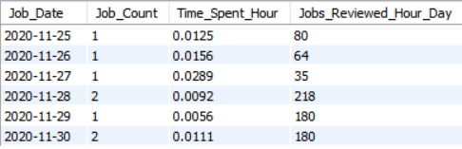
Question 1 - SQL Statement
01) Jobs Reviewed Over Time: Calculate the number of jobs reviewed per hour for each day in November 2020.
Your Task: Write an SQL query to calculate the number of jobs reviewed per hour for each day in November 2020.
SELECT
CAST(ds AS DATE) AS Job_Date,
COUNT(job_id) AS Job_Count,
SUM(time_spent)/3600 AS Time_Spent_Hour,
ROUND(COUNT(job_id)/(SUM(time_spent)/3600)) AS Jobs_Reviewed_Hour_Day
FROM
job_data
WHERE
CAST(ds AS DATE) >= '2020/11/01' AND CAST(ds AS DATE) <= '2020/11/30'
GROUP BY Job_Date
ORDER BY Job_Date;

Slide 10
Question 1 - Insights
28th November 2020 had the highest number of jobs reviewed per hour at 218
The lowest number of jobs reviewed per hour was on 27th November 2020 at 35.

Slide 11
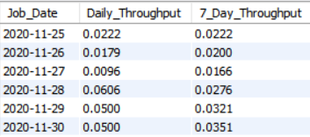
Question 2 - SQL Statement
02) Throughput Analysis: Calculate the 7-day rolling average of throughput (number of events per second).
Your Task: Write an SQL query to calculate the 7-day rolling average of throughput.
SELECT
CAST(ds AS DATE) AS Job_Date,
ROUND(COUNT(job_id) / SUM(time_spent),4) AS Daily_Throughput,
ROUND(AVG(COUNT(job_id) / SUM(time_spent)) OVER (ORDER BY CAST(ds AS DATE) ROWS BETWEEN 6 PRECEDING AND CURRENT ROW),4) AS 7_Day_Throughput
FROM
job_data
GROUP BY Job_Date
ORDER BY Job_Date;

Slide 12
Question 2 - Insights
What is Throughput
Throughput analysis is a method of measuring the efficiency of a business process by calculating the rate at which units move through the process from start to finish. It can help a business make decisions that minimize costs and maximize profits. Throughput analysis involves two components: inventory and flow time. Inventory is the number of units that are involved in the process at a given time, and flow time is the amount of time a unit spends in the process from start to finish. The formula for throughput rate is:
R=I/T
7-day rolling average v/s daily metric. Which is better in this situation?
A rolling average, sometimes referred to as a moving average, is a metric that calculates trends over short periods of time using a set of data. Specifically, it helps calculate trends when they might otherwise be difficult to detect.
An average/daily metric fluctuates wildly as each day can result in a different calculation. The rolling average creates a trend that can show a better picture over a long time.
In this situation, a 7-day rolling metric makes more sense, due to the fluctuation of the daily metric.

Slide 13
Question 2 - Insights
The graph shows the daily average and the 7 day rolling average
As observed via the graph, the rolling average is more consistent and less fluctuating. This will help to understand the trend better.

Slide 14
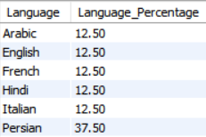
Question 3 - SQL Statement
03) Language Share Analysis: Calculate the percentage share of each language in the last 30 days.
Your Task: Write an SQL query to calculate the percentage share of each language over the last 30 days.
SELECT
DISTINCT language AS Language,
ROUND(((COUNT(language) OVER (PARTITION BY language)) / (COUNT(language) OVER ()) * 100),2) AS Language_Percentage
FROM job_data
WHERE
CAST(ds AS DATE) >= '2020/11/01'
AND CAST(ds AS DATE) <= '2020/11/30';

Slide 15
Question 3 - Insights
The Pie Chart shows the language percentage of jobs reviewed.
As per the chart, Persian Language jobs are reviewed the most with a share of 37.50%
All the other languages have the same percentage share of 12.5%

Slide 16
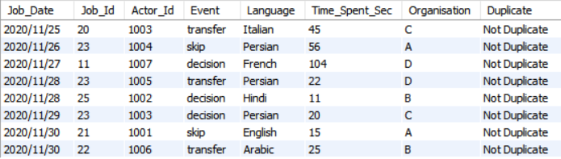
Question 4 - SQL Statement
04) Duplicate Rows Detection: Identify duplicate rows in the data.
Your Task: Write an SQL query to display duplicate rows from the job_data table.
SELECT ds AS Job_Date, job_id AS Job_Id, actor_id AS Actor_Id, event AS Event,
language AS Language, time_spent AS Time_Spent_Sec, org AS Organisation,
IF (Job_Count>1,"Duplicate","Not Duplicate") AS Duplicate
FROM
(SELECT *,
COUNT(*) OVER (PARTITION BY ds, job_id, actor_id, event, language,time_spent, org) AS Job_Count
FROM job_data) AS Tot_Count
ORDER BY Job_Date, Duplicate;

Slide 17
Question 4 - Insights
None of the fields are duplicates.
Note : All the columns in the table can be repeated and can have duplicates, so we need to assign a combination of two or more columns to allow for duplicate checks. For this project, I used a combination of all fields for the duplicate check (even though, this is not an ideal check). If a time field was present, it could be used as a primary key).

Slide 18
Case Study 2

Slide 19
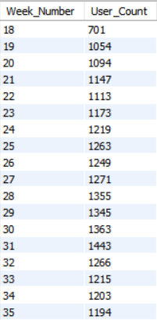
Question 1 - SQL Statement
01) Weekly User Engagement: Measure the activeness of users on a weekly basis.
Your Task: Write an SQL query to calculate the weekly user engagement.
SELECT
WEEK(occurred_at, 3) AS Week_Number,
COUNT(DISTINCT user_id) AS User_Count
FROM
events
GROUP BY Week_Number
ORDER BY Week_Number;

Slide 20
Question 1 - Insights
The highest weekly user engagement was in Week 31 at 1443 users
There is a slight upward trend in user engagement over the weeks
The lowest weekly user engagement was in Week 19 at 1054 users. (Week 18 is not taken into account as it does not have all days)

Slide 21
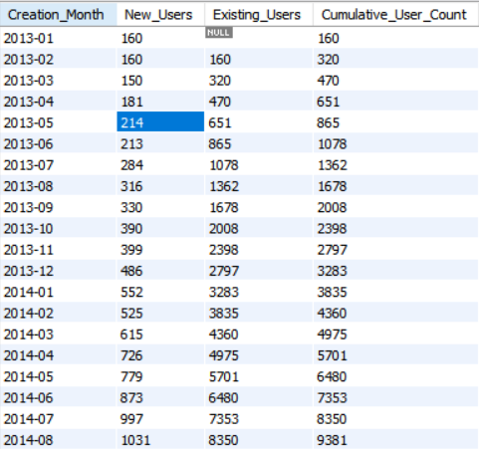
Question 2 - SQL Statement
02) User Growth Analysis: Analyse the growth of users over time for a product.
Your Task: Write an SQL query to calculate the user growth for the product.
SELECT
DATE_FORMAT(created_at,'%Y-%m') AS Creation_Month,
COUNT(user_id) AS New_Users,
SUM(COUNT(user_id)) OVER (ORDER BY DATE_FORMAT(created_at,'%Y-%m') ROWS BETWEEN UNBOUNDED PRECEDING AND 1 PRECEDING) AS Existing_Users,
SUM(COUNT(user_id)) OVER (ORDER BY DATE_FORMAT(created_at,'%Y-%m') ROWS BETWEEN UNBOUNDED PRECEDING AND CURRENT ROW) AS Cumulative_User_Count
FROM users
GROUP BY Creation_Month;

Slide 22
Question 2 - Insights
We can notice a steady upward increase of weekly user registrations.
The total number of users are 9381.

Slide 23
Question 3 - SQL Statement
03) Weekly Retention Analysis: Analyse the retention of users on a weekly basis after signing up for a product.
Your Task: Write an SQL query to calculate the weekly retention of users based on their sign-up cohort.
SELECT
first_week,
SUM(CASE WHEN Week_Number = 0 THEN 1 ELSE 0 END) AS week_0,
SUM(CASE WHEN Week_Number = 1 THEN 1 ELSE 0 END) AS week_1,
SUM(CASE WHEN Week_Number = 2 THEN 1 ELSE 0 END) AS week_2,
SUM(CASE WHEN Week_Number = 3 THEN 1 ELSE 0 END) AS week_3,
SUM(CASE WHEN Week_Number = 4 THEN 1 ELSE 0 END) AS week_4,
SUM(CASE WHEN Week_Number = 5 THEN 1 ELSE 0 END) AS week_5,
SUM(CASE WHEN Week_Number = 6 THEN 1 ELSE 0 END) AS week_6,
SUM(CASE WHEN Week_Number = 7 THEN 1 ELSE 0 END) AS week_7,
SUM(CASE WHEN Week_Number = 8 THEN 1 ELSE 0 END) AS week_8,
SUM(CASE WHEN Week_Number = 9 THEN 1 ELSE 0 END) AS week_9,
SUM(CASE WHEN Week_Number = 10 THEN 1 ELSE 0 END) AS week_10,
SUM(CASE WHEN Week_Number = 11 THEN 1 ELSE 0 END) AS week_11,
SUM(CASE WHEN Week_Number = 12 THEN 1 ELSE 0 END) AS week_12,
SUM(CASE WHEN Week_Number = 13 THEN 1 ELSE 0 END) AS week_13,
SUM(CASE WHEN Week_Number = 14 THEN 1 ELSE 0 END) AS week_14,
SUM(CASE WHEN Week_Number = 15 THEN 1 ELSE 0 END) AS week_15,
SUM(CASE WHEN Week_Number = 16 THEN 1 ELSE 0 END) AS week_16,
SUM(CASE WHEN Week_Number = 17 THEN 1 ELSE 0 END) AS week_17
SQL Statement continued on next slide

Slide 24
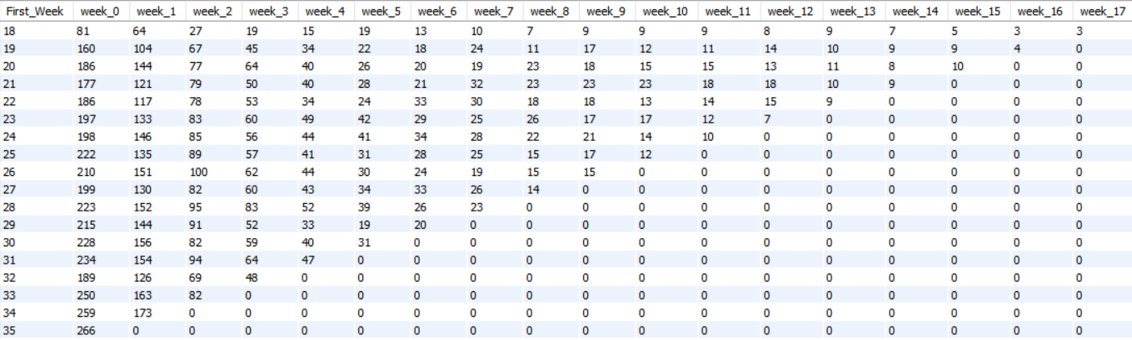
Question 3 - SQL Statement (Continued)
FROM
(SELECT b.user_id, Week_Occurred, First_Week, (Week_Occurred-First_Week) AS Week_Number
FROM
(SELECT user_id, week(occurred_at,3) AS Week_Occurred
FROM events
GROUP BY user_id, Week_Occurred
ORDER BY user_id, Week_Occurred) AS a
RIGHT JOIN
(SELECT user_id, min(week(occurred_at,3)) AS First_Week
FROM events
WHERE event_type='signup_flow'
GROUP BY user_id
ORDER BY user_id) AS b
ON a.user_id = b.user_id) AS Week_Number_Select
GROUP BY First_Week
ORDER BY First_Week;

Slide 25
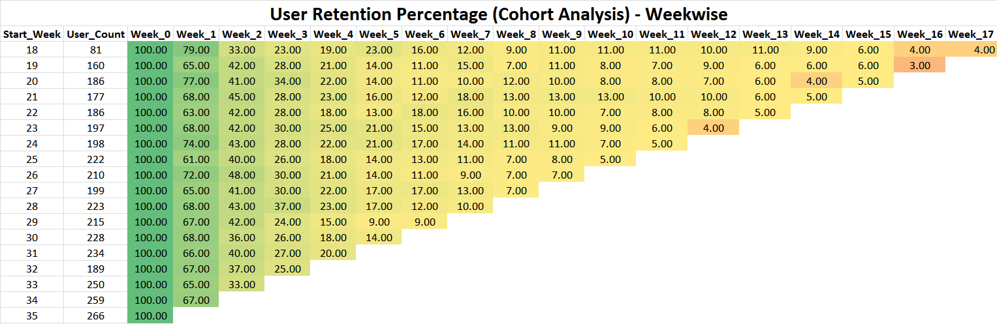
Question 3 - Insights
The chart above shows the User Retention Percentage (Signup Cohort) - Weekwise.

Slide 26
Question 4 - SQL Statement
04) Weekly Engagement Per Device: Measure the activeness of users on a weekly basis per device.
Your Task: Write an SQL query to calculate the weekly engagement per device.
SELECT
Device,
SUM(CASE WHEN Week_Number = 18 THEN Tot_Count ELSE 0 END) AS Week_18,
SUM(CASE WHEN Week_Number = 19 THEN Tot_Count ELSE 0 END) AS Week_19,
SUM(CASE WHEN Week_Number = 20 THEN Tot_Count ELSE 0 END) AS Week_20,
SUM(CASE WHEN Week_Number = 21 THEN Tot_Count ELSE 0 END) AS Week_21,
SUM(CASE WHEN Week_Number = 22 THEN Tot_Count ELSE 0 END) AS Week_22,
SUM(CASE WHEN Week_Number = 23 THEN Tot_Count ELSE 0 END) AS Week_23,
SUM(CASE WHEN Week_Number = 24 THEN Tot_Count ELSE 0 END) AS Week_24,
SUM(CASE WHEN Week_Number = 25 THEN Tot_Count ELSE 0 END) AS Week_25,
SUM(CASE WHEN Week_Number = 26 THEN Tot_Count ELSE 0 END) AS Week_26,
SUM(CASE WHEN Week_Number = 27 THEN Tot_Count ELSE 0 END) AS Week_27,
SUM(CASE WHEN Week_Number = 28 THEN Tot_Count ELSE 0 END) AS Week_28,
SUM(CASE WHEN Week_Number = 29 THEN Tot_Count ELSE 0 END) AS Week_29,
SUM(CASE WHEN Week_Number = 30 THEN Tot_Count ELSE 0 END) AS Week_30,
SUM(CASE WHEN Week_Number = 31 THEN Tot_Count ELSE 0 END) AS Week_31,
SUM(CASE WHEN Week_Number = 32 THEN Tot_Count ELSE 0 END) AS Week_32,
SUM(CASE WHEN Week_Number = 33 THEN Tot_Count ELSE 0 END) AS Week_33,
SUM(CASE WHEN Week_Number = 34 THEN Tot_Count ELSE 0 END) AS Week_34,
SUM(CASE WHEN Week_Number = 35 THEN Tot_Count ELSE 0 END) AS Week_35,
SUM(Tot_Count) AS Total_Count
SQL Statement continued on next slide

Slide 27
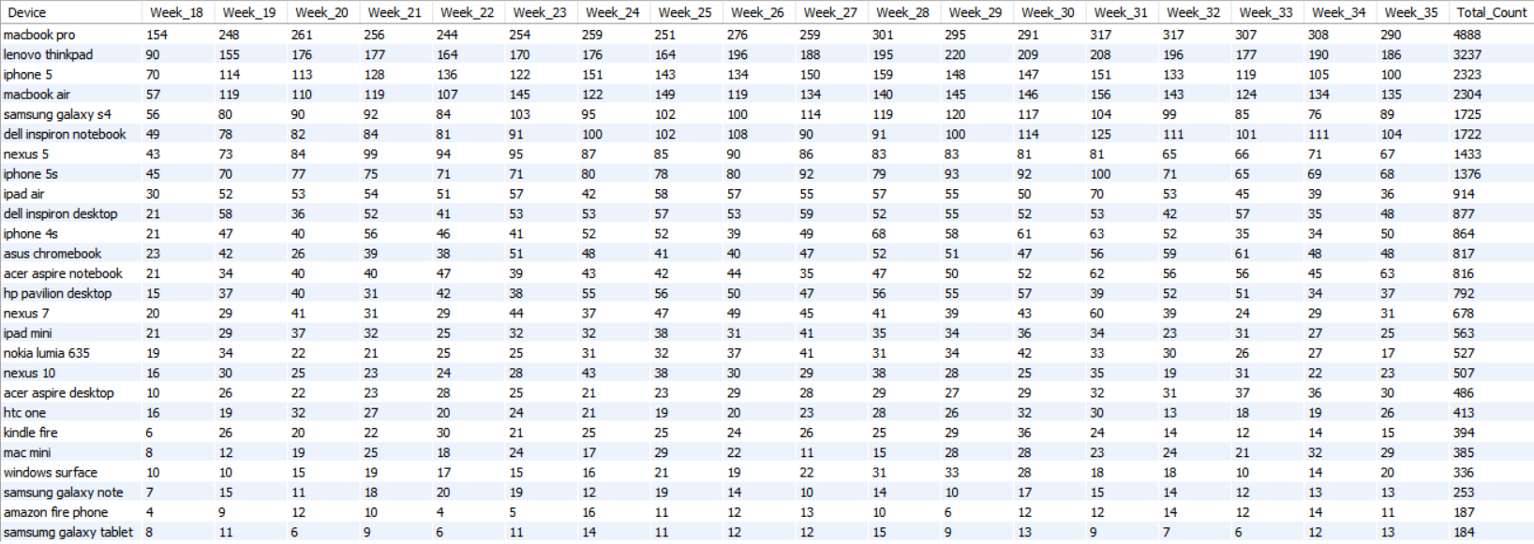
Question 4 - SQL Statement (Continued)
04) Weekly Engagement Per Device: Measure the activeness of users on a weekly basis per device.
Your Task: Write an SQL query to calculate the weekly engagement per device.
FROM
(SELECT WEEK(occurred_at,3) AS Week_Number,device AS Device,COUNT(DISTINCT user_id) AS Tot_Count
FROM events WHERE event_type='engagement‘
GROUP BY user_id, Device, Week_Number
ORDER BY user_id, device) AS Query
GROUP BY Device
ORDER BY Total_Count DESC;

Slide 28
Question 4 - Insights
The device with highest weekly engagement is Macbook Pro with an average engagement of 271.5.
The device with lowest weekly engagement is Samsung Galaxy Tablet with an average engagement of 10.2.

Slide 29
Question 5 - SQL Statement
05) Email Engagement Analysis: Analyse how users are engaging with the email service.
Your Task: Write an SQL query to calculate the email engagement metrics.
SELECT
WEEK(occurred_at, 3) AS Week_Number,
COUNT((CASE WHEN action = 'email_clickthrough' THEN user_id END)) AS Email_ClickThrough,
COUNT((CASE WHEN action = 'email_open' THEN user_id END)) AS Email_Open,
COUNT((CASE WHEN action = 'email_clickthrough' THEN user_id END)) + COUNT((CASE WHEN action = 'email_open' THEN user_id END)) AS Total_Email_Opened,
COUNT((CASE WHEN action = 'sent_reengagement_email' THEN user_id END)) AS Reengagement_Email_Sent,
COUNT((CASE WHEN action = 'sent_Weekly_digest' THEN user_id END)) AS Weekly_Digest_Sent,
COUNT((CASE WHEN action = 'sent_reengagement_email' THEN user_id END)) + COUNT((CASE WHEN action = 'sent_Weekly_digest' THEN user_id END)) AS Total_Emails_Sent,
COUNT(DISTINCT user_id) AS Tot_User_Count
FROM
email_events
GROUP BY Week_Number
ORDER BY Week_Number;
Result on Next Slide

Slide 30
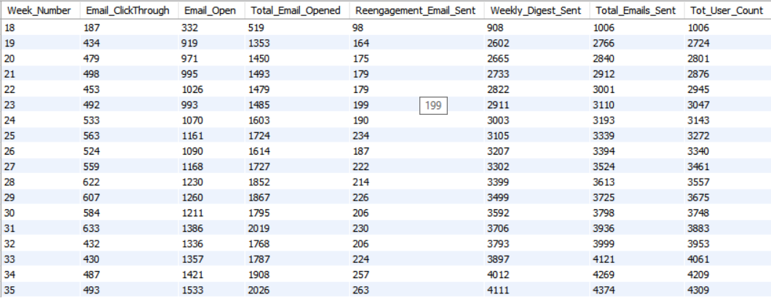
Question 5 - SQL Statement (Continued)

Slide 31
Question 5 - Insights
Less than 50% of the emails sent are opened by users

Slide 32
Question 5 – Insights 2
Most of the emails sent are Weekly Digests
Less than 50% Users are opening emails, out of which less than 50% are clicking through.

Slide 33
Results
The project allowed me to advance my SQL skills through research and further learning. It has also allowed me to provide valuable insights based on the given data. ​
The project was a great learning experience as I was able to research new concepts in SQL, Excel and Data Visualisation. I also gained hands on experience in a real-world project, which allowed me to learn new business concepts related to various metrics.​
Through the use of SQL queries, I was able to extract insightful analysis from operational data. The insight gained from this data will help improve the company's operations and understand sudden changes in key metrics.​

Slide 34

THANK YOU

